Slide 1


Real-Time Sign Language Interpretation
Bridging Communication Gaps with Innovative Technology
INSTRUCTOR : Guangjing Wang
Presenters: Srinija Reddy Maddula
Rasmitha Chinthalapally
Vishal Varma Vuddaraju
Group 10

Slide 2

Introduction
Sign language interpretation is crucial for effective communication with the deaf and hard-of-hearing community. Despite its importance, there is a significant shortage of qualified interpreters, leading to communication barriers. Sign Language Interpreter, aims to address this issue by leveraging advanced technology to provide accessible and efficient interpretation services.
1

Slide 3

Motivation
5%
72%
75%
Use sign language globally
Families don’t sign with Deaf children
Deaf individuals face job challenges
Need for real-time, AI-based sign language interpretation
2

Slide 4
Related work
Rule- based systems
Glove based systems
Computer vision based approaches
Existing Apps
3

Slide 5

Proposed solution
Real-time Hand Gesture Recognition using CNN & OpenCV.
Converts hand gestures into text & voice output.
Offline Mode
Scalable & Extendable
Real-time processing for seamless communication.
4

Slide 6
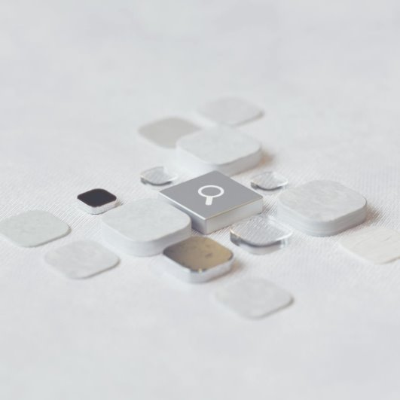
Dataset
ASL gesture dataset.
Open-source repositories
Custom recordings.(per gesture 2400 img)
LSA64
5

Slide 7
Data Preparation
Data Collection
Preprocessing
Augmentation
Splitting
Feature Extraction
6

Slide 8
Technologies and tools
Python
TensorFlow/Keras
OpenCV
SQLite
pyttsx3
7
Notes:
"We used:
Python for development.
TensorFlow/Keras for building the CNN models.
OpenCV for image processing.
SQLite for simple local data storage.
pyttsx3 library to convert text outputs to voice."

Slide 9
Data Augmentation
Implementation
Enhances dataset by flipping images horizontally
Preprocessing and dataset preparation
Reads images, converts them to grayscale, and normalizes pixel values. Finally, splits the dataset.
Setting Up Hand Histogram
Captures the skin tone histogram to segment hand gestures from the background.
Training CNN model
Trains a CNN for sign language recognition and saves the best model in .h5 file.
Creating and labeling Gestures
Captures images of different hand signs and stores them in directory after labeling.
Real-Time Gesture Recognition
Converts recognized gestures into text and speech output
8
Notes:
"Here’s how we built our project step-by-step:
First, we captured and labeled images of different hand gestures.
Then, we set up a hand histogram to easily separate the hand from the background.
After that, we augmented the data by flipping and adjusting the images to make our model stronger.
Next, we preprocessed the images — turning them into grayscale, normalizing them, and splitting into training and testing sets.
We then trained a CNN model to recognize the gestures and saved the best version.
Finally, we achieved real-time gesture recognition, where the system turns gestures into text and speech instantly."

Slide 10

Challenges
Low accuracy on complex gestures
Background Noise in Camera Feed
Sign Variation Across Users
9
Notes:
In our project, we faced some challenges:
First, we got low accuracy when it came to recognizing complex gestures that had different movements.
Second, the background noise from the camera feed sometimes confused the model which made the recognition harder.
Finally, sign variation across different users —its like different hand shapes or signing styles which made it difficult for the model to stay consistent."

Slide 11

Solutions
Increased dataset size & used data augmentation.
Applied image thresholding & hand segmentation.
Added multiple variations for each gesture.
10
Notes:
To overcome the mentioned before challenges, we took three main steps:
We increased the dataset size and applied data augmentation to make the model learn better variations.
We applied image thresholding and hand segmentation to clean up the background and focus just on the hand gestures.
Finally, we added multiple variations for each gesture, so the model could generalize better across different users.

Slide 12

TRUSTWORTHINESS ENHANCEMENT STRATEGIES
Fairness:
Training data included different types of hand gestures from diverse users to help the model work well for everyone.
Robustness:
Tested model with varied lighting, motion blur, and different backgrounds.
Data Augmentation:
Applied rotations, brightness adjustments, and flips to simulate real-world variability.
Continuous Validation:
Regular evaluation of misclassifications to retrain and improve the model.
11
Notes:
In our project, we focused on several strategies to make the system more trustworthy:
For Fairness, We didn’t run a big user study, but while preparing the data, we included hand signs from different kinds of people so that the model treats everyone fairly.
For Robustness, we tested the model under different lighting, motion blur, and backgrounds to check if it stays accurate in real-world conditions.
We used Data Augmentation techniques like rotation, brightness changes, and flipping images to create more training examples and cover more variations.
Lastly, with Continuous Validation, we regularly checked where the model was making mistakes and retrained it to keep improving accuracy."

Slide 13
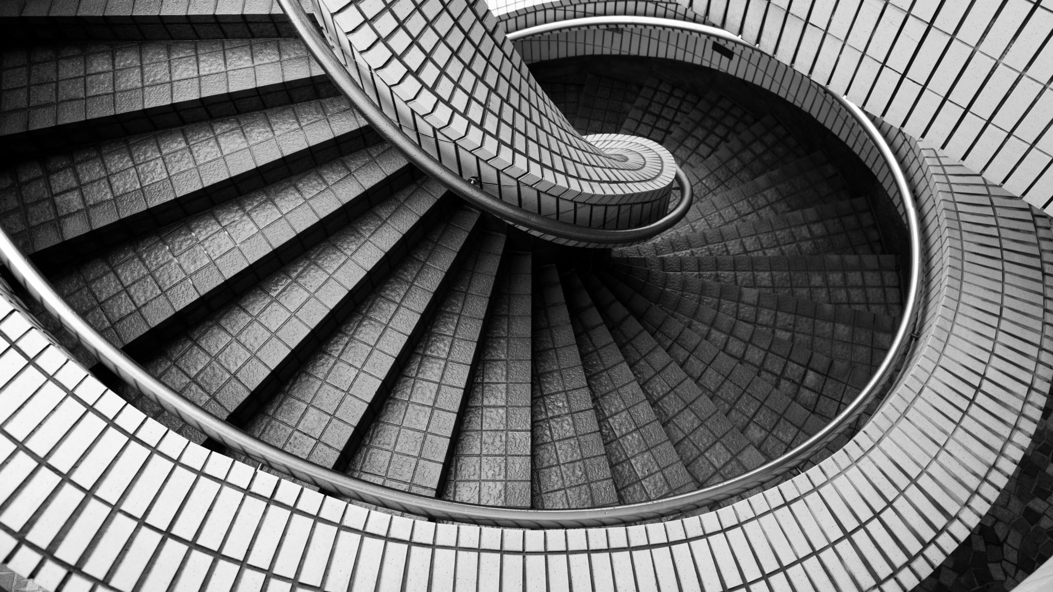
Trustworthy Aspects
Notes:
now, we will see how we made our model more trustworthy. Like how We focused on key areas like robustness, fairness, and consistent validation, by making sure that the system works reliably in different conditions and for all kinds of users

Slide 14

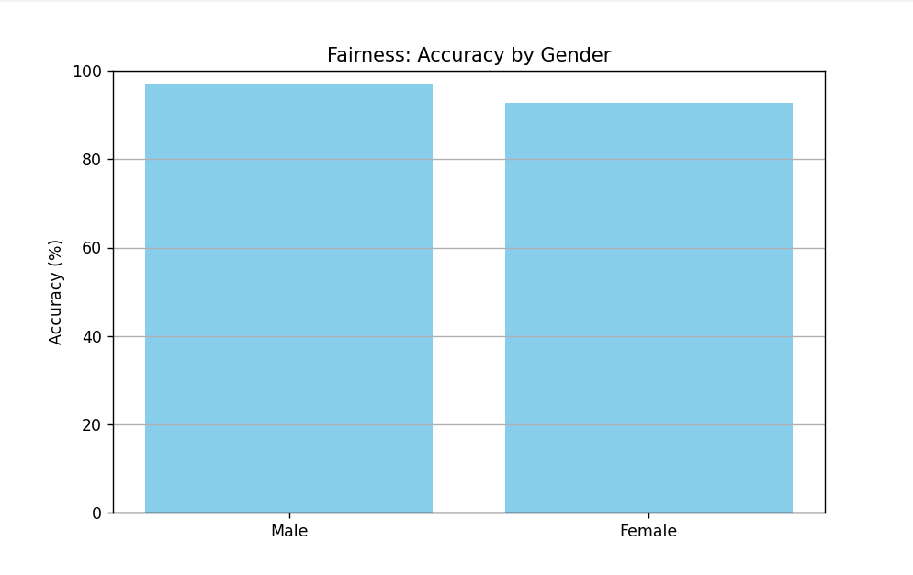
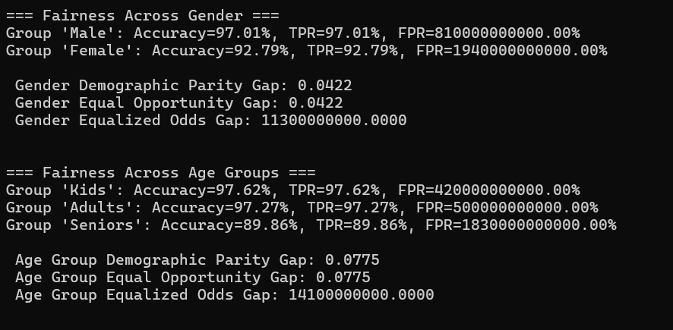
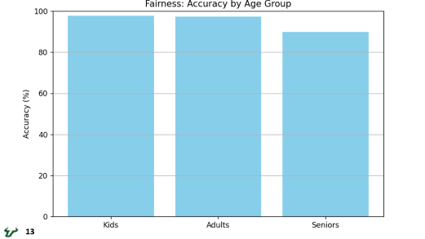
Fairness and Bias
Dataset Diversity
Demographic Testing
Fairness Metrics
Results
12
Notes:
To make our model fair, we used a diverse dataset that included gestures from different age groups and genders. next We also tested fairness using two important metrics:
First one is Demographic Parity which means the model should predict gestures equally for all groups, ignoring the age and gender.
Then the Second one is Equal Opportunity it checks if the model is good at recognizing correct gestures for everyone equally. finally, these steps helped us in making sure that our model treats all users fairly.

Slide 15
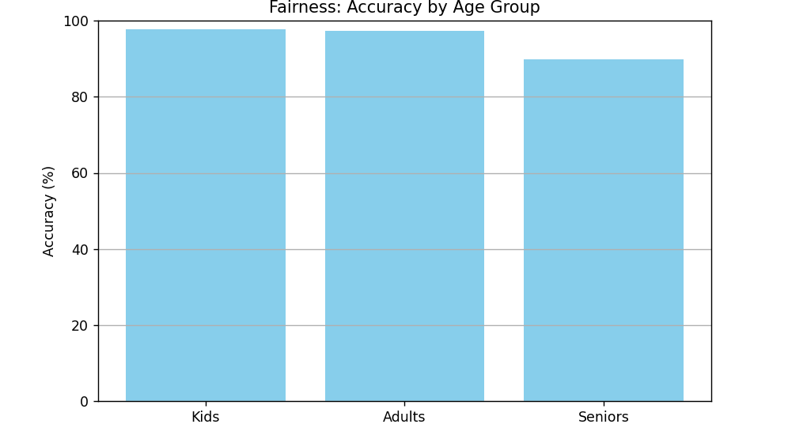
13
Notes:
The graph here shows how our model is performing across different age groups like Kids, Adults, and Seniors. As you can see, the accuracy is quite high for all groups but slightly lower for Seniors which is still very close. This is indicating that our model is generally fair and consistent across different age groups

Slide 16
14
Notes:
Similarly this graph shows model accuracy for male and female participants. The model performs slightly better for males but still maintains high accuracy for both genders. This shows that our system is also fair across different gender groups.

Slide 17
15
Notes:
We calculated fairness metrics to check how equally our model works across gender and age groups. As we can see For gender, the accuracy for males was 97.01% and for females it is around 92.79%, with a small demographic parity gap of about 4%. For age groups, kids and adults had about about 97% accuracy, whereas seniors has slightly lower accuracy around 90%, with a gap of around 7.7%. These small gaps show that while the model is fairly consistent, there is still some room for improvement, especially for seniors and females. Overall, the fairness scores are quite good and suggest the model works reliably across diverse users."

Slide 18

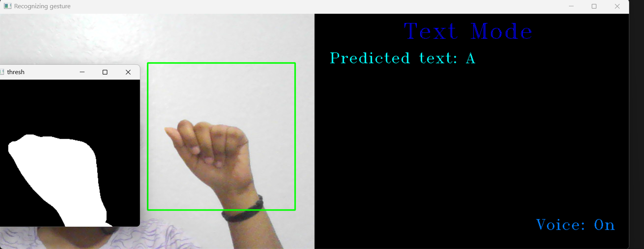
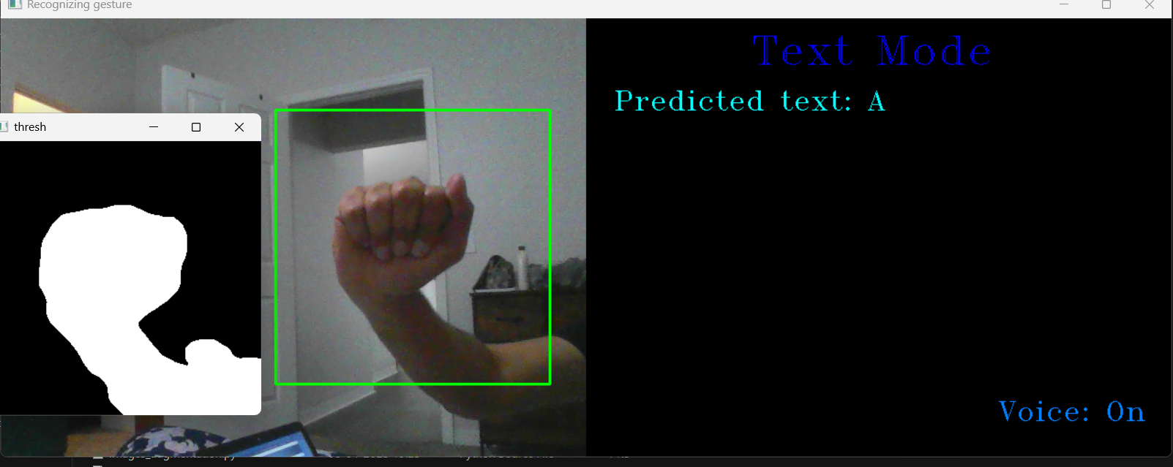
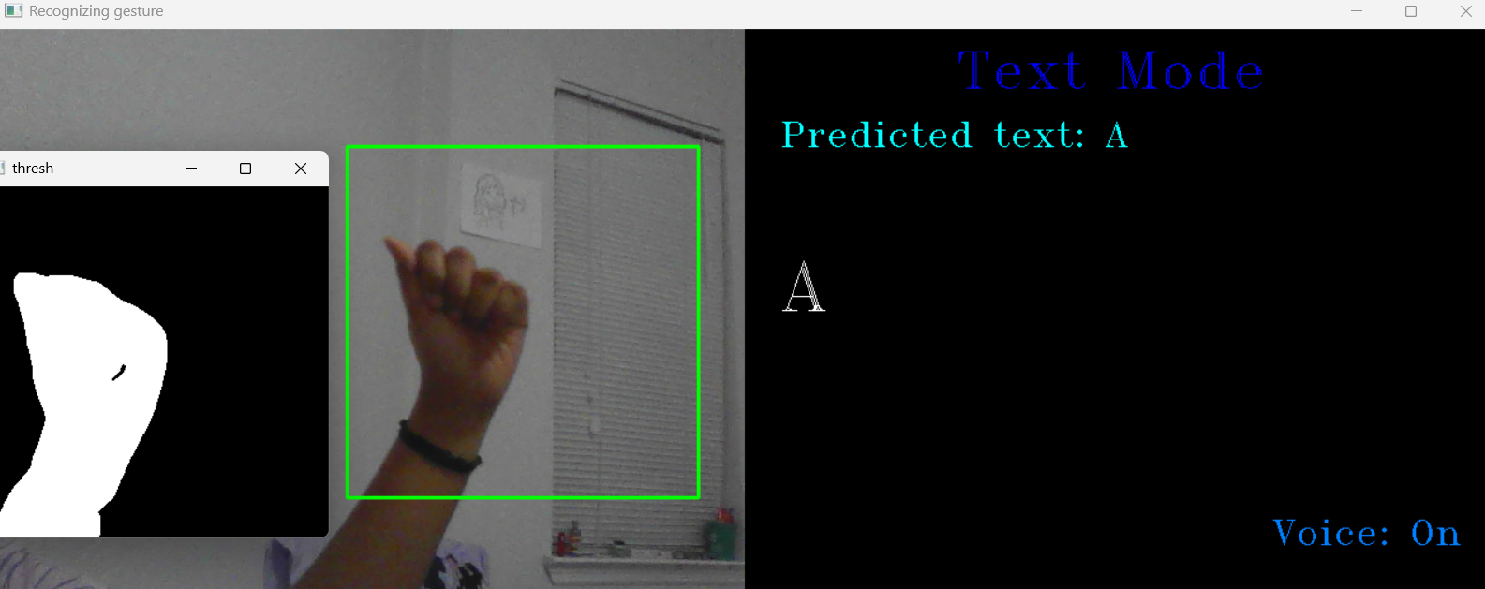
Robustness
Real-world Variability
Noise tolerance
Overfitting Prevention
Resilience to Input Errors
Continuous Testing
16
Notes:
To make our model strong and reliable, we tested it under real-world conditions like different lighting, backgrounds, and camera quality. We made sure that the model could tolerate noise, like blurry images or small background disturbances. To prevent overfitting, we used techniques like data augmentation during training. We also checked how the model reacts to small input errors — like if a hand is not perfectly centered — and made sure it still predicts correctly. Finally, we kept testing continuously to catch and fix problems early, making the model more resistent for real-world use
The pictures show how our model is recognizing hand gestures even in different backgrounds, lighting, and angles. Despite changes like brightness, cluttered backgrounds, or camera quality, the model still correctly detects the hand region and predicts the right gesture, which proves its robustness

Slide 19
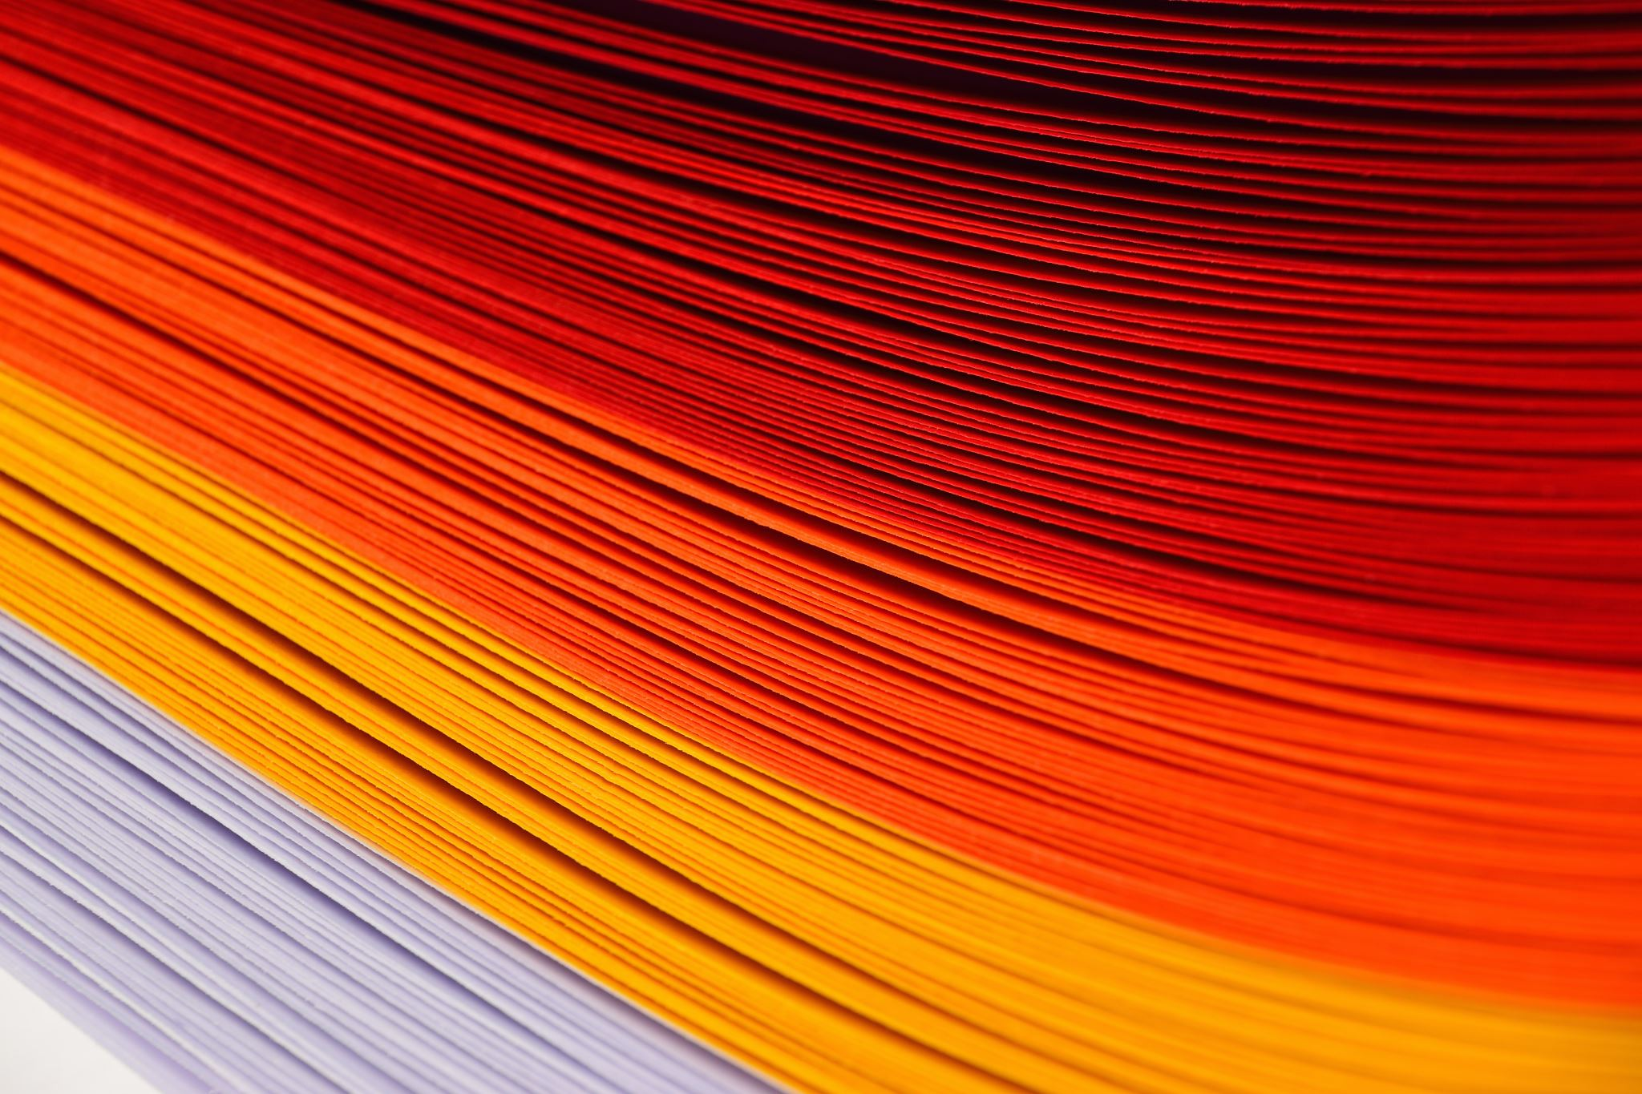
ROLES AND CONTRIBUTIONS
Srinija Reddy Maddula
Handled documentation & reporting compiled results, generated performance visualizations, and summarized trustworthiness improvements.
Rasmitha Chinthalapally Led fairness evaluation — organized user study, collected diverse gesture data, and analyzed performance across user groups.
Vishal Varma Vuddaraju Conducted robustness testing, created test scenarios with lighting variations, motion blur, and background changes.
17
Notes:
in our project, I worked on the fairness evaluation. I ensured we had a diverse dataset by including different age groups and genders. I also helped in analyzing how the model performed across different user groups and suggested ways to make it more fair."
"My teammate Vishal Varma Vuddaraju handled robustness testing. He created different real-world scenarios, like changing lighting, adding motion blur, and different backgrounds to make sure our model is stable and reliable."
"Srinija Reddy Maddula focused on documentation and reporting. She compiled the final results, created performance visualizations, and summarized all the trustworthiness improvements in a clear and organized way

Slide 20
Future Scope
Mobile App Deployment for accessibility.
Integration with Virtual Assistants (Alexa, Google Assistant).
Continuous Gesture Recognition
Multi-Sign Language Support
18
Notes:
In future, we can make our system even more accessible by deploying it as a mobile app, so users can easily use it We can also integrate our model with virtual assistants like Alexa and Google Assistant to make communication even smoother. We can improve continuous gesture recognition, allowing the system to understand gestures in real-time without need of any pause after every sign. Finally, we can expand our project to support multiple sign languages, making it useful for a larger and more diverse audience.

Slide 21

Conclusion
Achieves real-time gesture recognition with high accuracy using CNNs. Built a real-time sign language interpreter using CNN and OpenCV, ensuring fairness with diverse datasets and robustness through testing under different conditions. The system delivers fast and reliable text and voice outputs.
19
Notes:
To conclude, we successfully built a real-time sign language interpreter using CNN and OpenCV. Our system achieved high accuracy in recognizing gestures and worked well even under different real-world conditions. We also focused on fairness by using diverse datasets and tested robustness to ensure reliability. Overall, our system delivers quick and accurate text and voice outputs, making communication easier

Slide 22
Thank You

